Slide 1
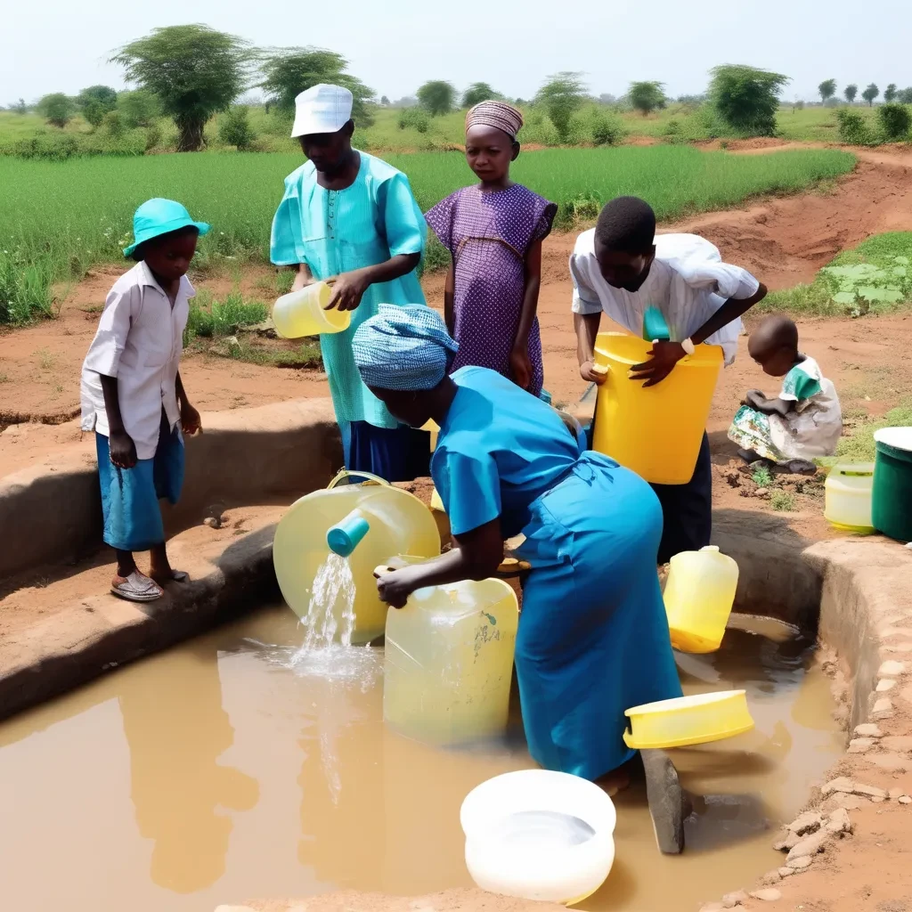
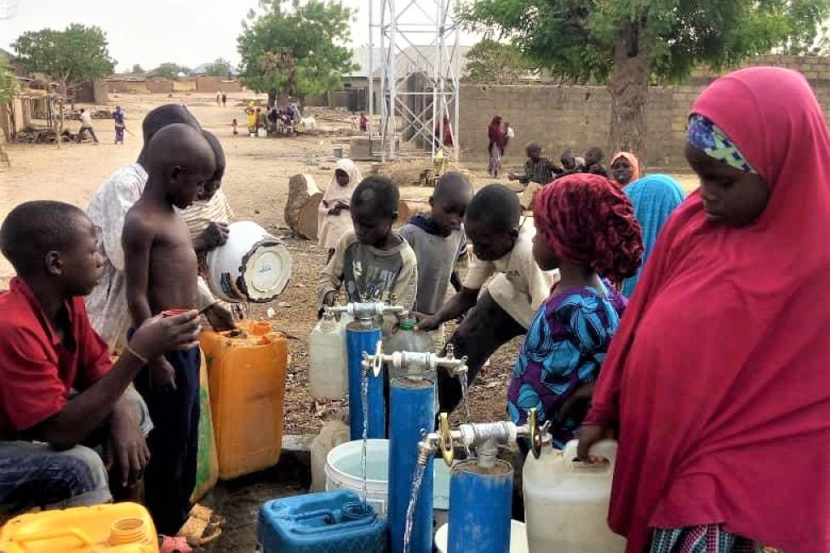
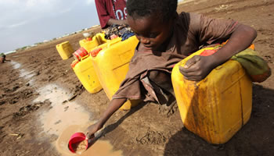
Problem statement: Access to Clean Water in Rural Nigeria
The lack of reliable access to clean drinking water in rural Nigeria is a growing crisis. This issue affects health, education, and economic development, perpetuating cycles of poverty and hindering sustainable growth

Slide 2
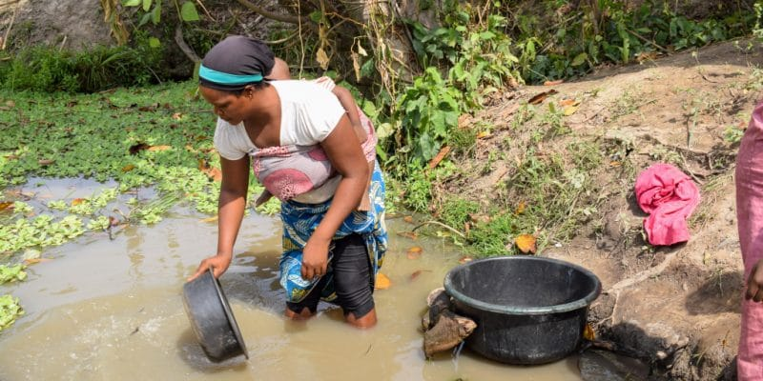
Personal Impact
Image source: Afrik21 (2021)
In regions without access to clean water, waterborne diseases thrive, leading to significant health crises. These illnesses contribute to over 30% of hospital visits, straining healthcare systems and affecting community well-being. Improving water quality is vital for reducing disease incidence and enhancing overall public health in vulnerable populations.

Slide 3
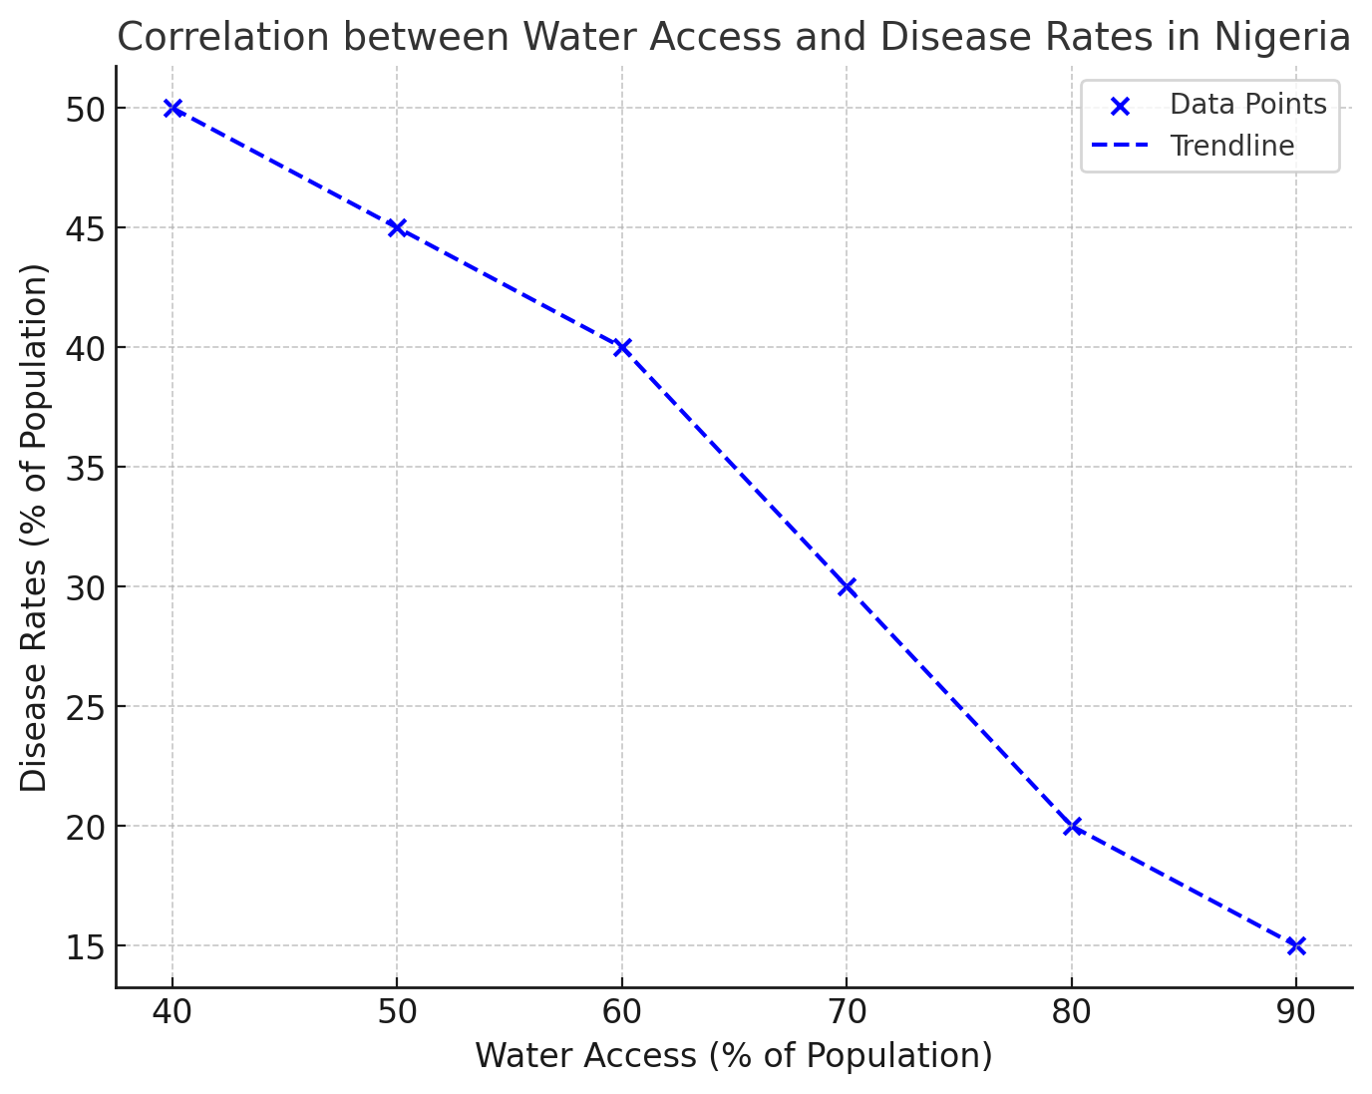
Health Implications
Waterborne diseases are prevalent in areas lacking clean water; they account for over 30% of hospital visits. Source: World Health Organization (2021).

Slide 4
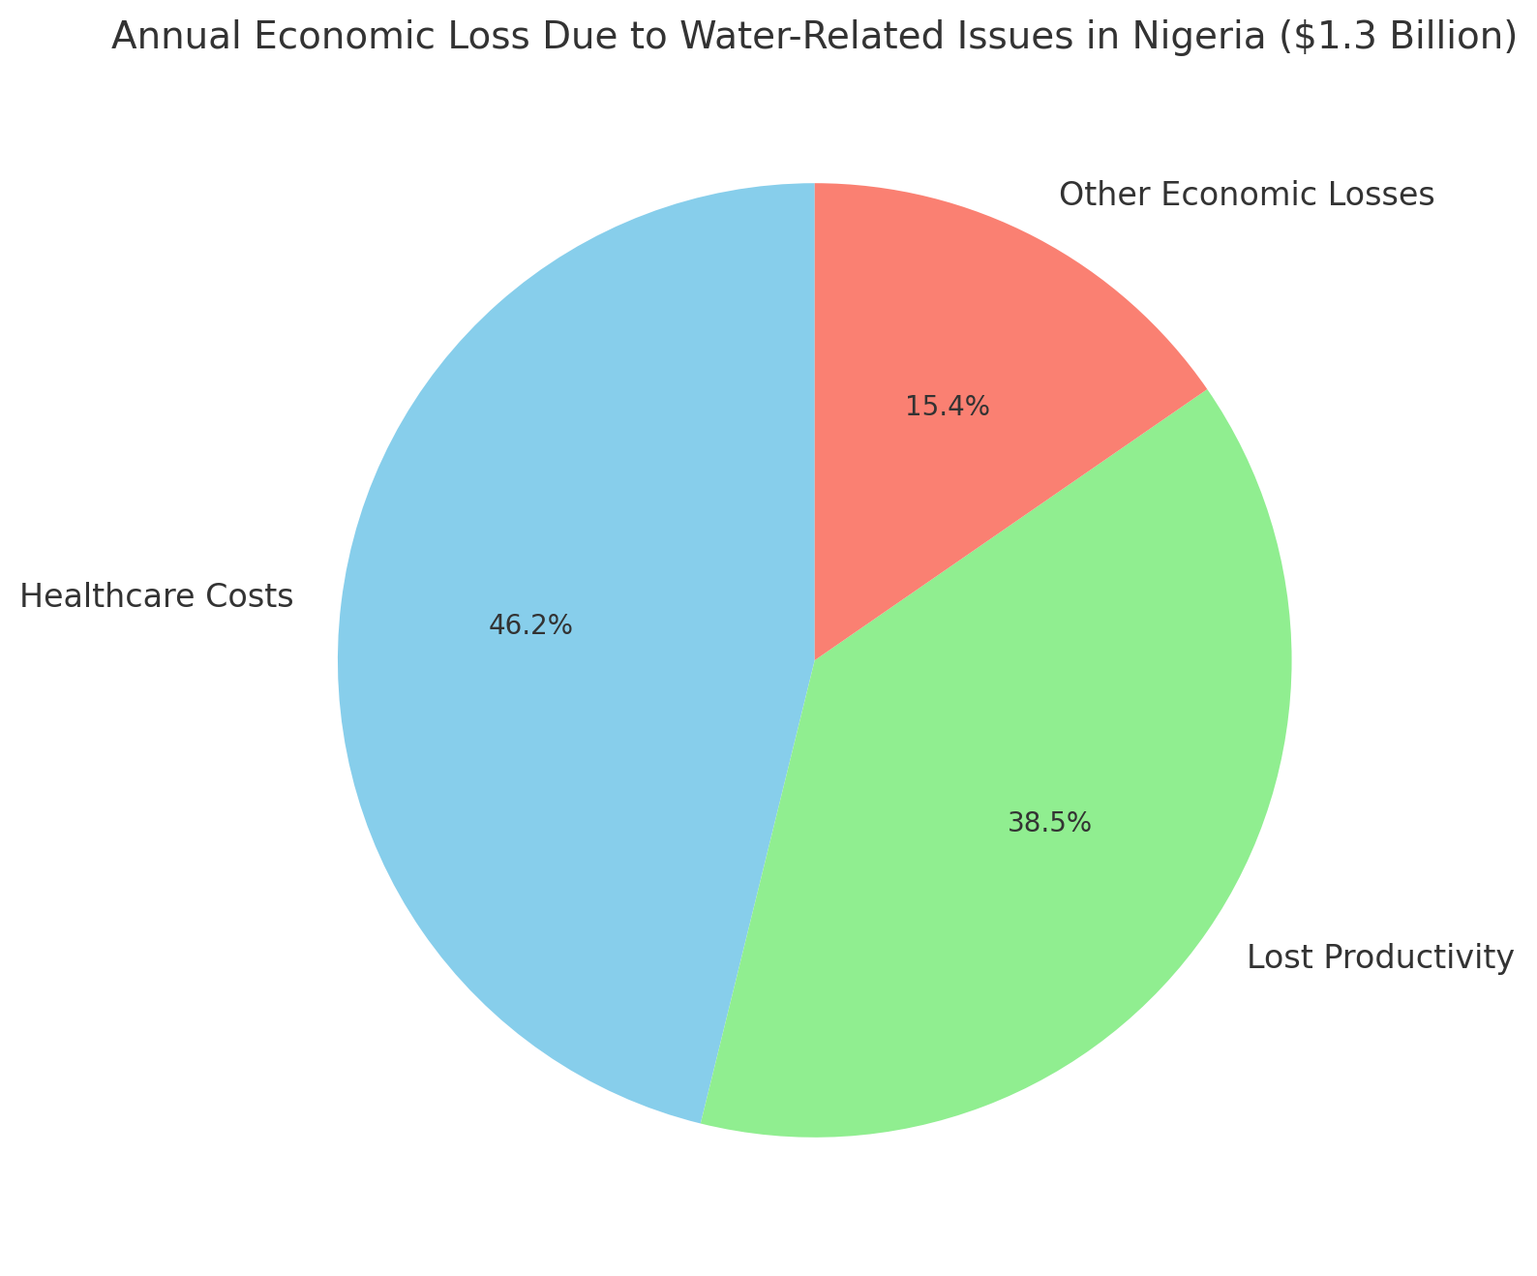
Economic Impact
Nigeria loses approximately $1.3 billion annually due to water-related issues. Source: World Bank (2016).

Slide 5
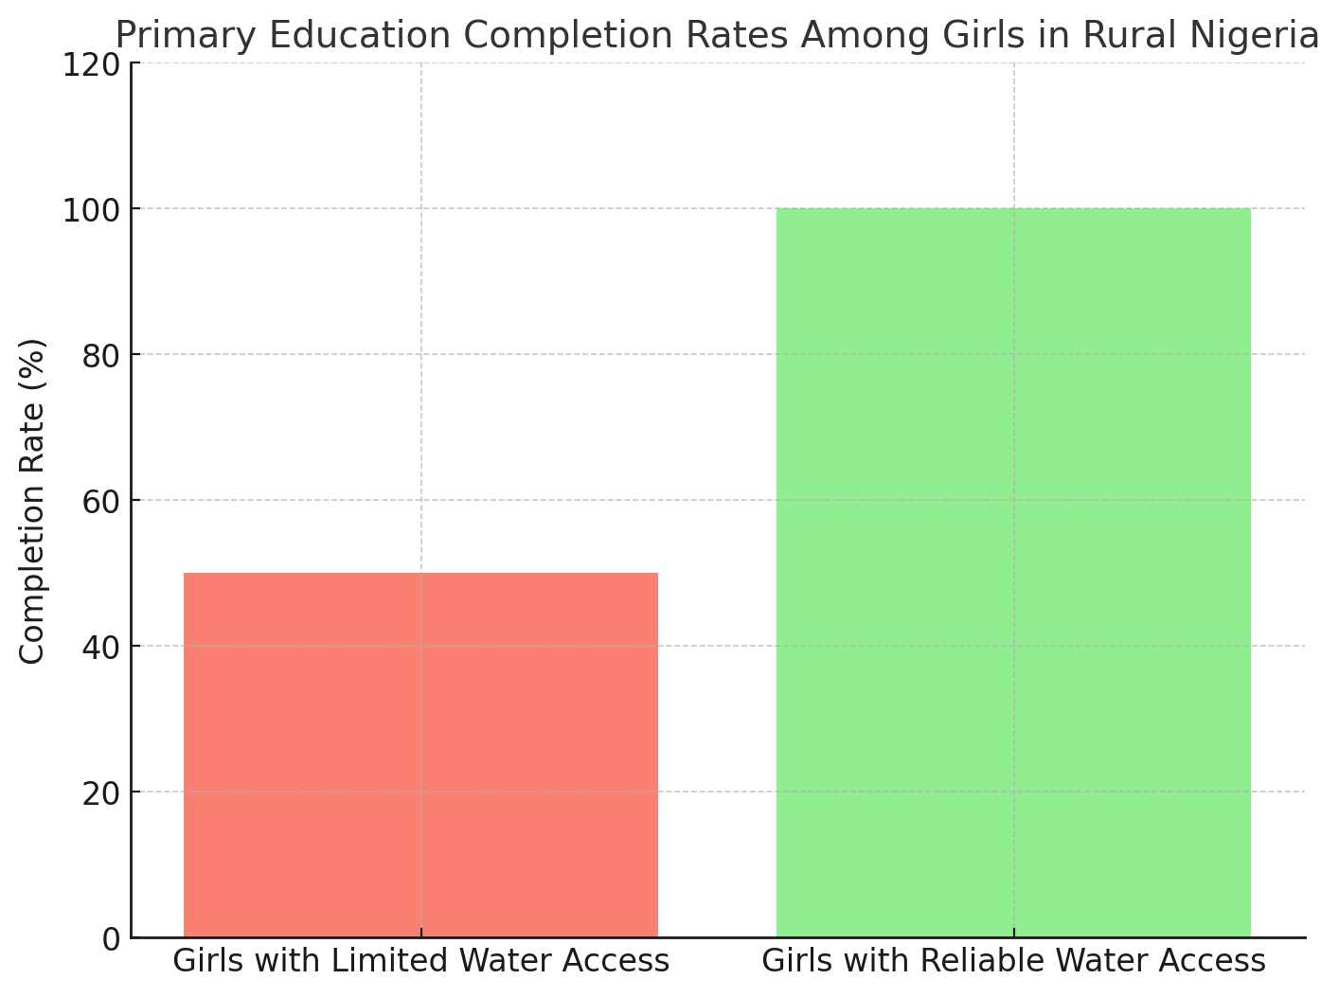
Education Consequences
Girls in rural areas with limited access to water are 50% less likely to complete primary education. Source: UNICEF (2020).

Slide 6
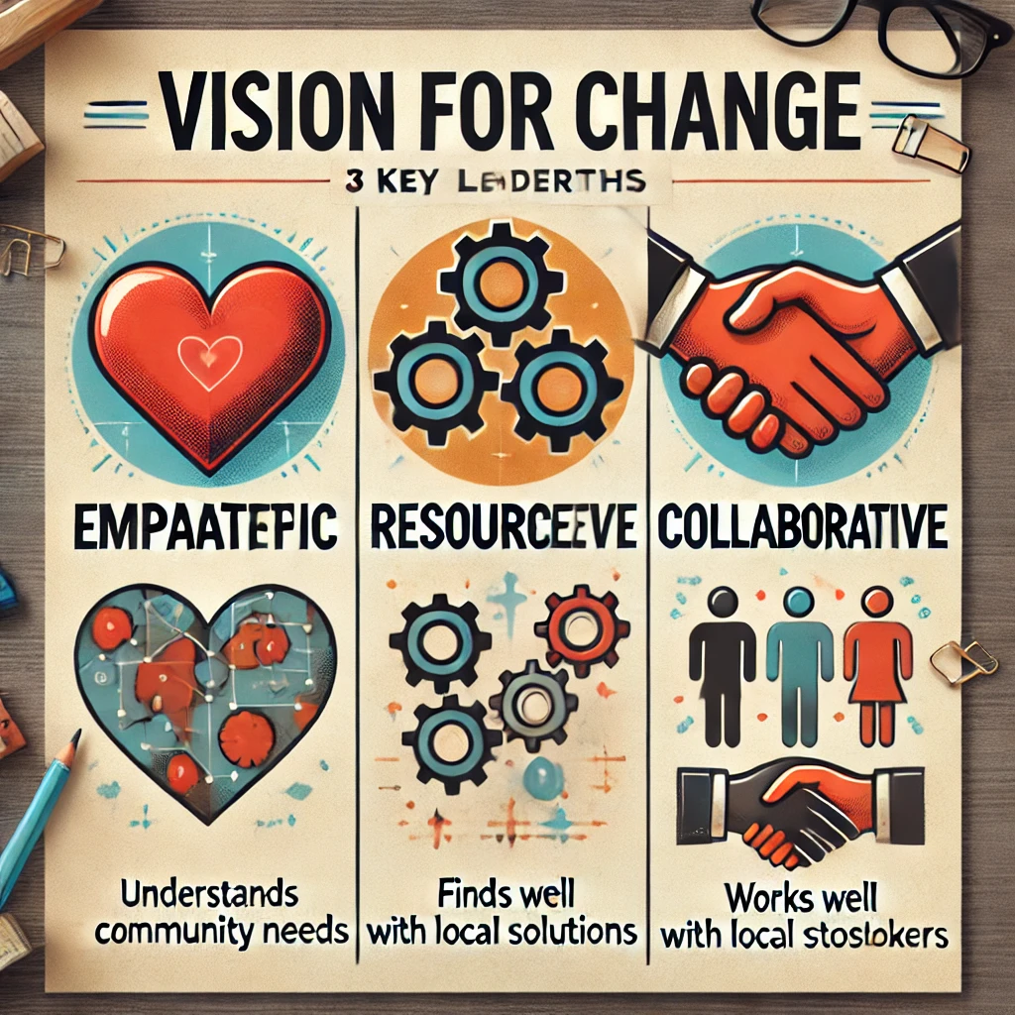
Goal Setting
To solve this problem, we need a collaborative leader who is empathetic, resourceful, and community-focused.
Breakdown
Empathetic: Understands community needs.
Resourceful: Finds innovative solutions.
Collaborative: Works well with local stakeholders.

Slide 7
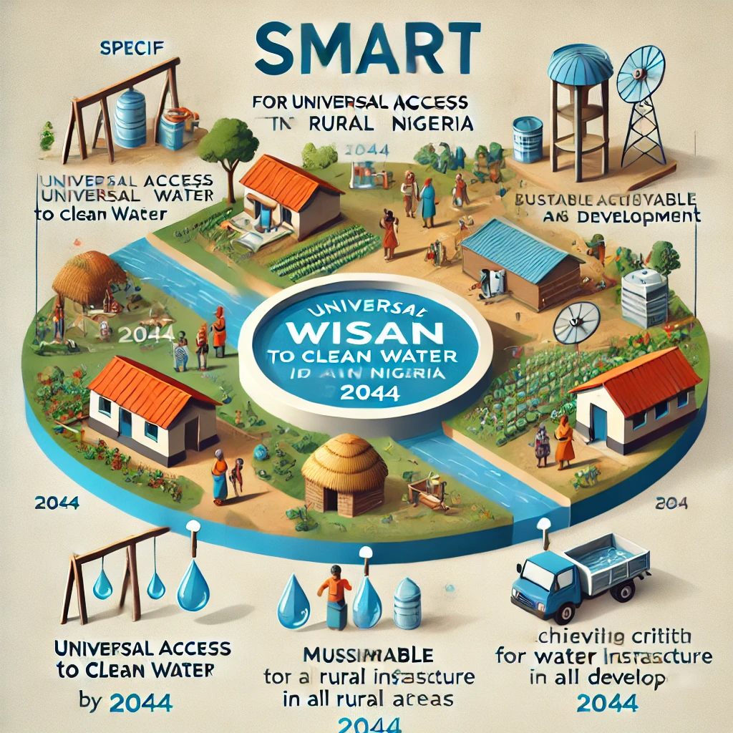
20-Year Goal (Long-Term Vision)
Increase clean water access by 50% in targeted rural communities by 2034.

Slide 8
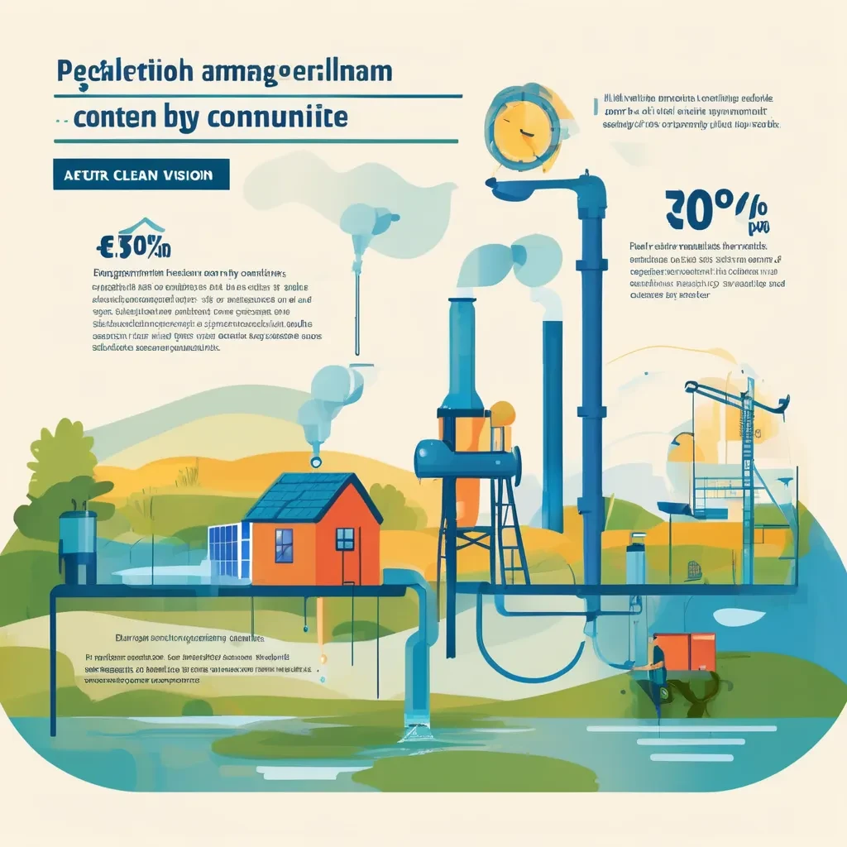
10-Year Goal (mid-Term Vision)
Increase clean water access by 50% in targeted rural communities by 2034.

Slide 9
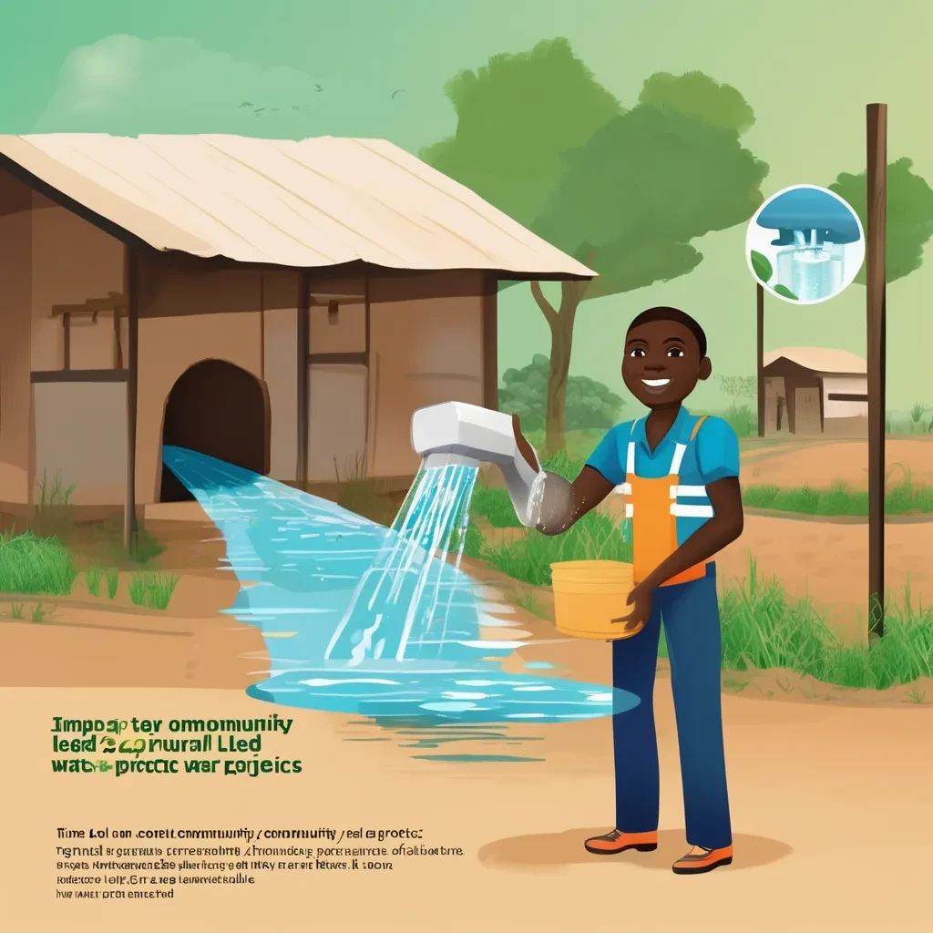
5-Year Goal (Shorter-Term Vision)
Implement 20 community-led water projects in rural Nigeria by 2029.

Slide 10
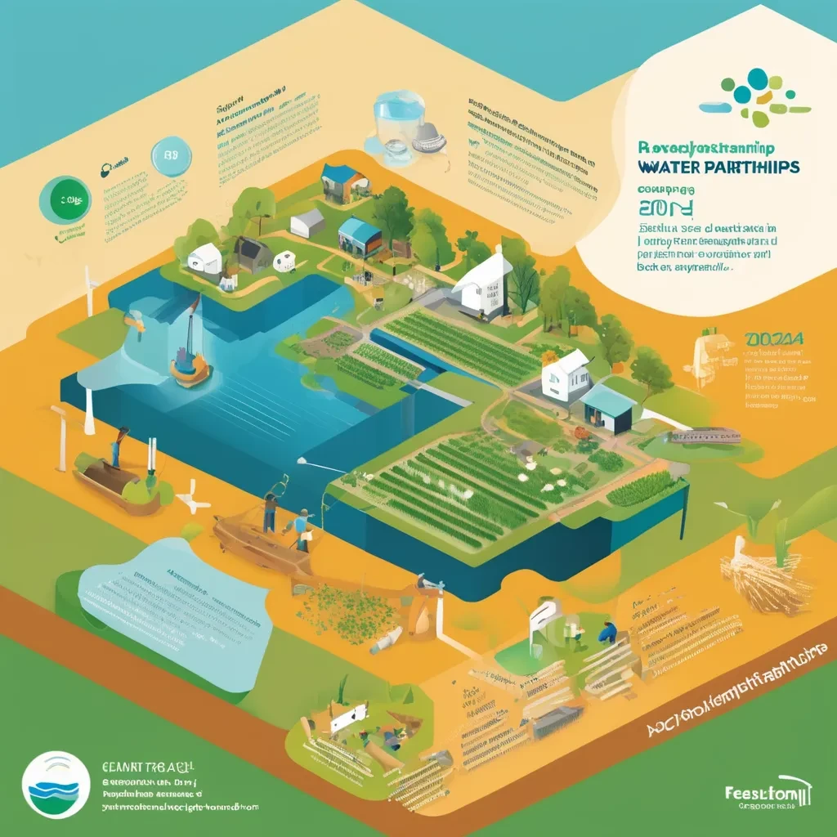
1-Year Goal (Immediate Steps)
Develop partnerships with local NGOs to assess water needs in 5 rural communities by the end of 2024.

Slide 11

Appendix
audience identification: The target audience comprises stakeholders in global health and development, including policymakers, NGOs, and community leaders. They can address the clean water crisis in rural Nigeria through funding, partnerships, and innovative solutions. Engaging this audience is essential for mobilizing resources and implementing effective strategies to improve water access and public health.
Users persona
Name: Amina Abubakar
Gender: Female
Age: 32
Profession: Community Health Worker
Education History: Bachelor's degree in Public Health
Annual Income: 3million naira
Access to Technology: Limited; uses a smartphone for communication and information
Relevant Information: Amina works in a rural area in Nigeria, focusing on health education and water access initiatives. She advocates for clean water solutions, understanding their impact on community health and education. Amina is committed to improving living conditions for her community and actively seeks innovative partnerships.

